Slide 1

Analyses of genome data Day 2 Tuesday, 1 December 2021
Maria Izabel Cavassim Alves

Slide 2

Recap of yesterday’s lecture and exercise
What have we learned so far?
https://docs.google.com/document/d/1F2k2Gw2NGMdCLOgfOTfXwpp6rFI9MYf7kCjIt1XgsJk/edit?usp=sharing

Slide 3
Day 2
Background lecture (45 minutes)
What is population structure?
How does population structure affect association mapping?
Break (15 minutes)
Hands on exercise (1 hour)
Population stratification detection
Population structure correction
Break (15 minutes)
Paper discussion on genome wide association studies
Assignment explanation (15 minutes)

Slide 4
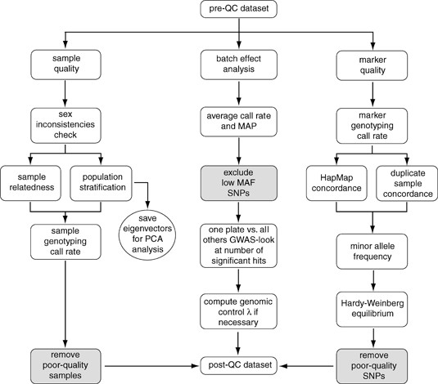
During yesterday’s exercise
Today we will discuss the importance of
correcting GWAS data for population structure!

Slide 5
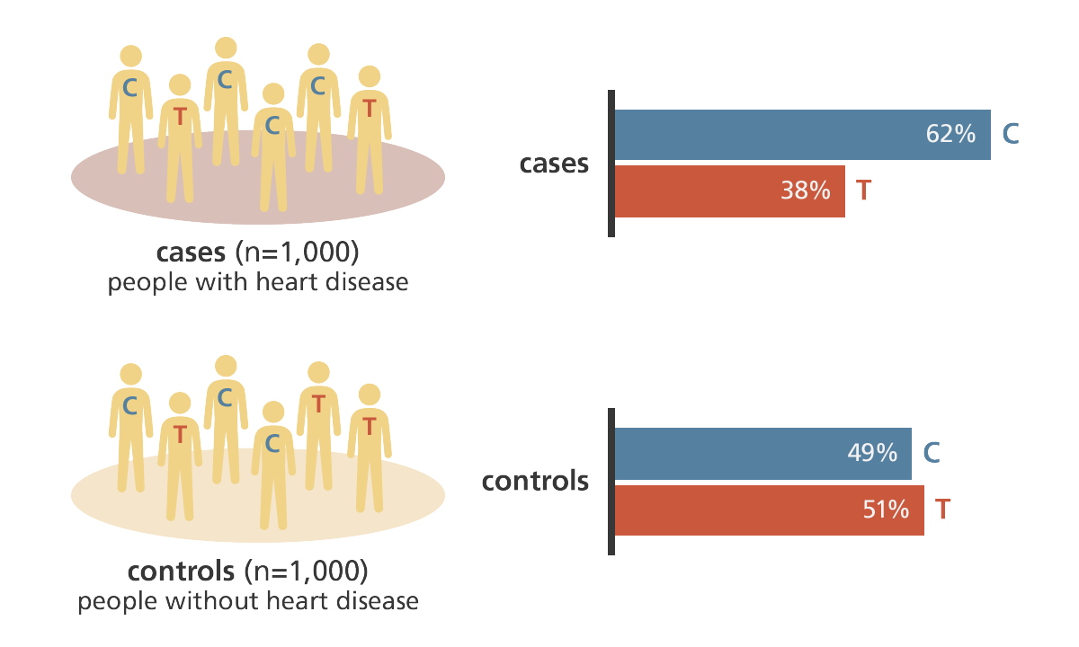
Genome Wide Association Studies

Slide 6
Genome Wide Association Studies: Fisher Exact test and test χ²
 | C/T | C/C | T/T
Cases
Control
To test whether or not a given SNP is associated
with an increase in disease risk we can use
a contingency table test:
Genotypic 2 degrees of freedom test
Fisher’s Exact test
χ² test

Slide 7
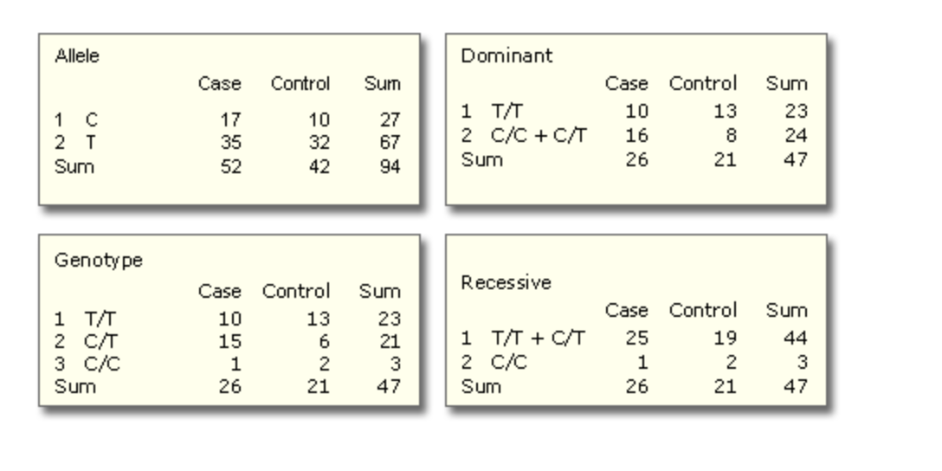
Different association tests with Plink

Slide 8
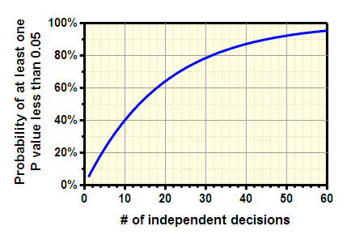
Multiple testing problem
Each association test between an SNP and a trait/disease is a χ² test. In GWAS testing a million SNPs is a million χ² tests (or linear regressions), each with its own null hypothesis. Each test would yield its own P value. The consideration of whether a particular P value is significant is based on the significance threshold assigned a priori during study design. The significance threshold, or α level, is the probability of rejecting the null hypothesis when the null hypothesis is true.
Consider an α level of 0.05: assuming the null hypothesis is true, we can expect to find one SNP to be “significantly” associated with the trait in question simply by chance alone while examining 20 SNPs (because 1/20 = 0.05). Examining 1 million SNPs would theoretically produce 50 000 “significant” SNPs by chance alone if an α level of 0.05 is chosen.

Slide 9
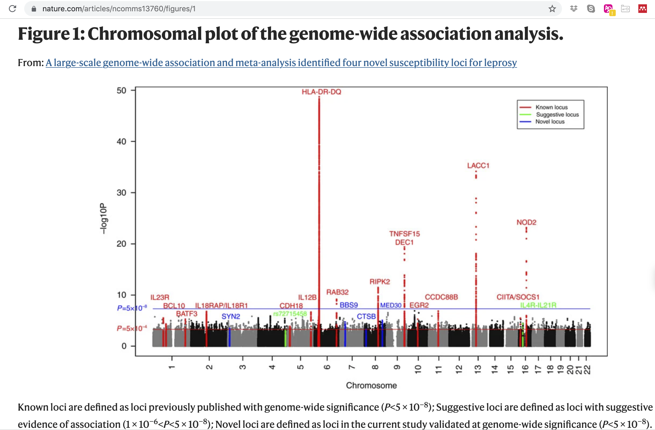
Correcting for multiple testing
• Bonferoni correction:
Only consider p-values below α/N significant
N: number of tests
• Standard genome-wide significance threshold needed
for publication: 5x10ˆ-8:

Slide 10
Quality control (Assignment 1)
• Some markers on SNP-chips fail in some way - this can lead to false positive findings. To Avoid this it is customary to:
• Exclude markers with high missingness.
• Exclude markers that show large deviations form Hardy-Weinberg equilibrium.
Exclude markers with low minor allele frequency (SNP-chips are generally not good at genotyping rare variants)
• Some samples have poor DNA quality, therefore it is customary to:
Exclude individuals with high missingness.
To avoid problems due to sample mix-ups or relatedness among samples it also customary to:
Test that the gender information matches the observed gender of each sample.
Test that there are no close relatives or duplicated samples in the data set

Slide 11
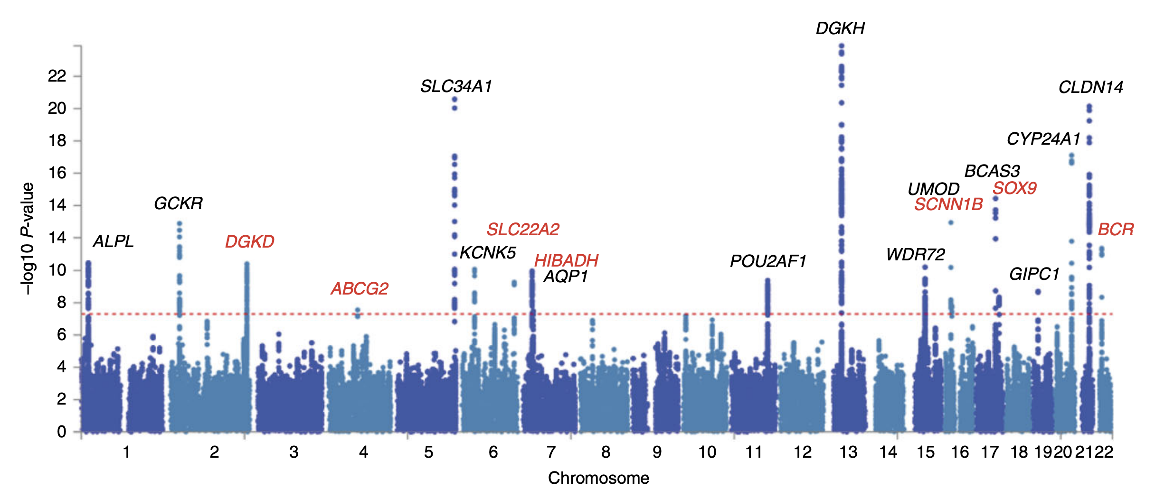
Manhattan plot from a GWAS of kidney stone disease
• Are the significant variants spread all over the genome?
• Are there significant variants that occur alone where other variants that should be in LD with the
variant show no signal?

Slide 12
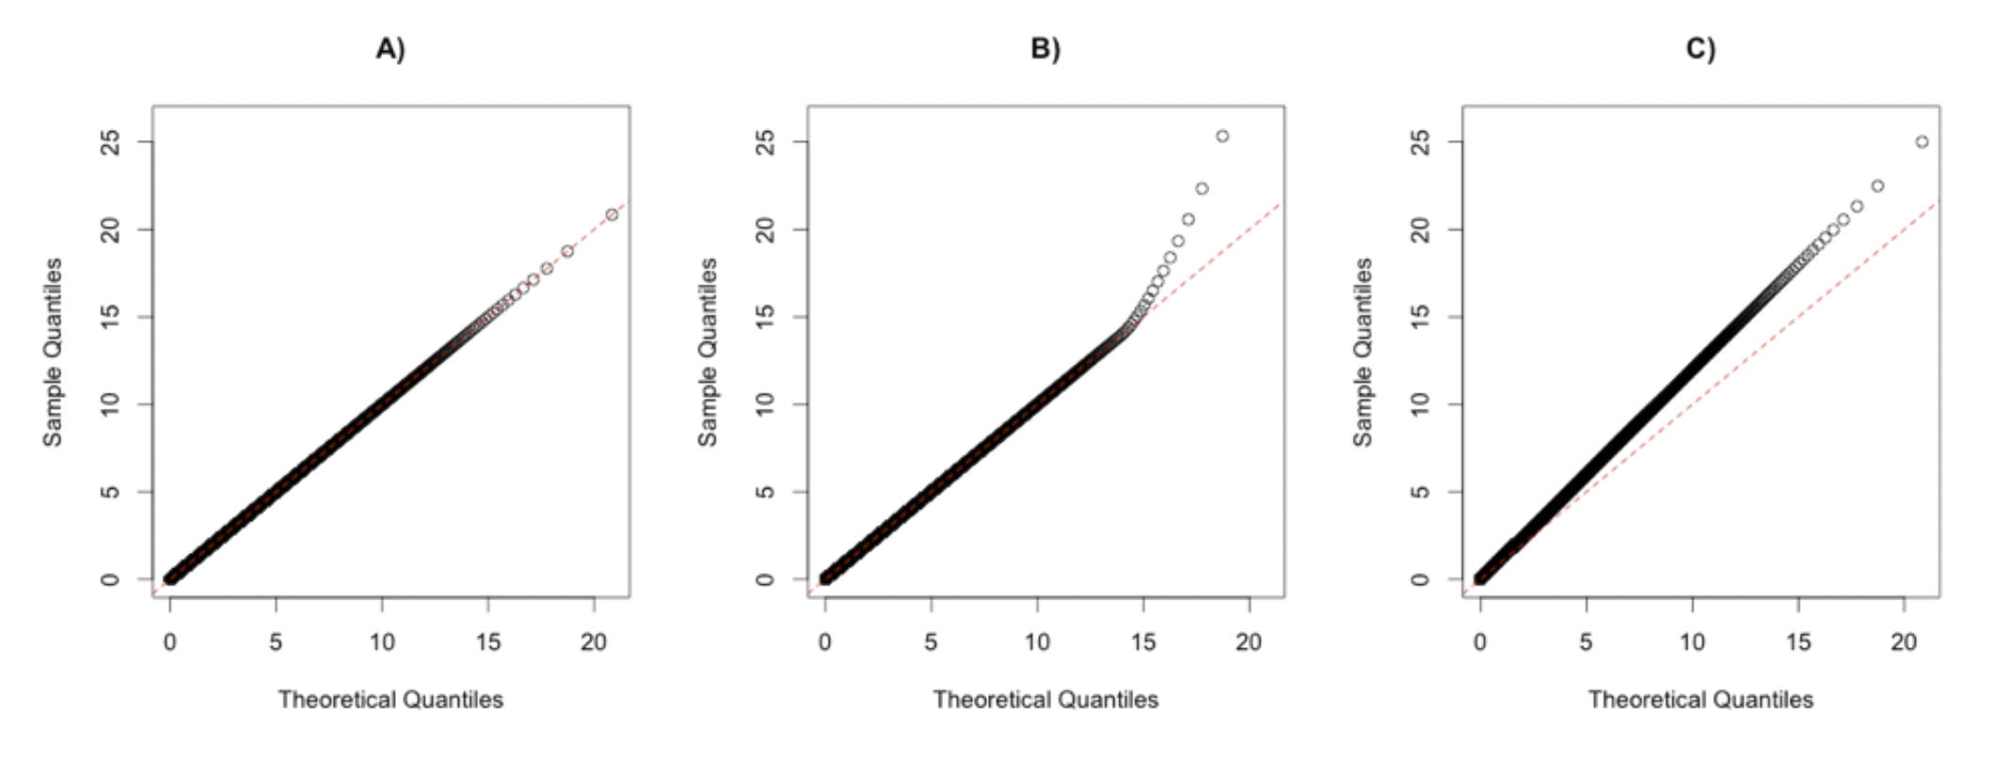
Quantile-Quantile plots (QQ-plots)
A) The observed values follow the expected distribution
B) Some observed variants higher than expected.
C) All observed variants higher than expected: sign of a problem.

Slide 13
Confounding factors
Confoundig factors in a GWAS study can occur when the differences between case and control are other than disease affectdness
For example:
• Differences in the genotyping.
Cases and controls should be genotyped using exactly the same genotyping technology.
Optimally the order of the genotyping should be randomized to avoid problems due to batch effects.
Differences in ethnicity (population structure!!)

Slide 14
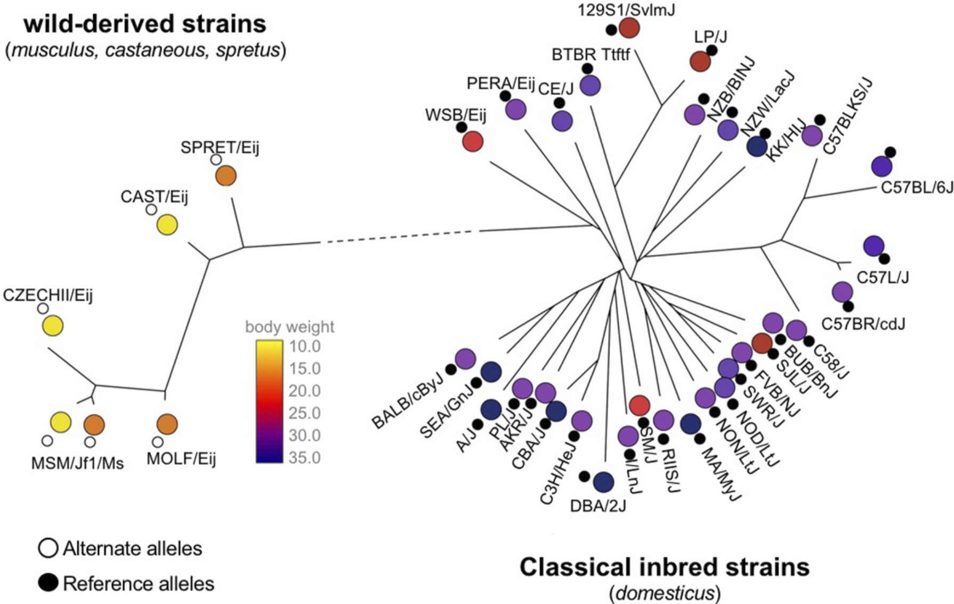
Population structure as a confounder
Suul et al., 2018

Slide 15
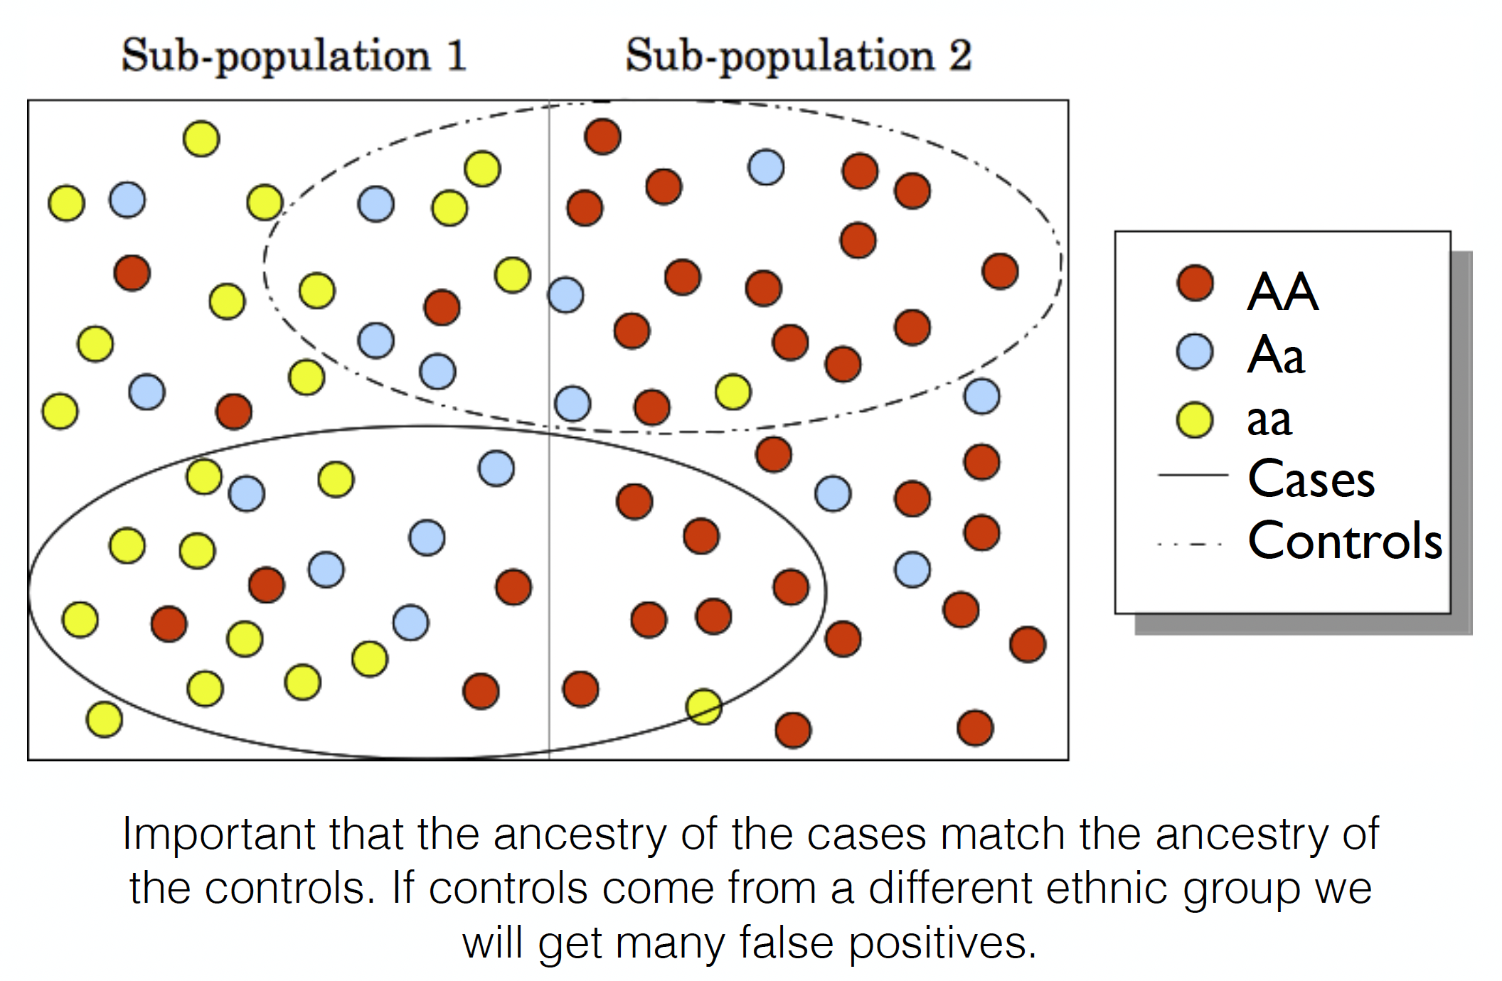
Population structure as a confounder

Slide 16
Population Structure Stratification
If the phenotype is correlated with structure, then structured markers are correlated with the phenotype.
What does this mean for association studies?
Will this affect all markers?
Balding et al., Nat Rev Genet 2006

Slide 17
What Causes Population Stratification Confounding
Population structure confounding arises in GWAS whenever:
The trait or disease correlates with structure and
The genetic variant being tested correlates with structure
This correlation can be driven by both true genetic effects and/or environmental factors
Balding et al., Nat Rev Genet 2006

Slide 18
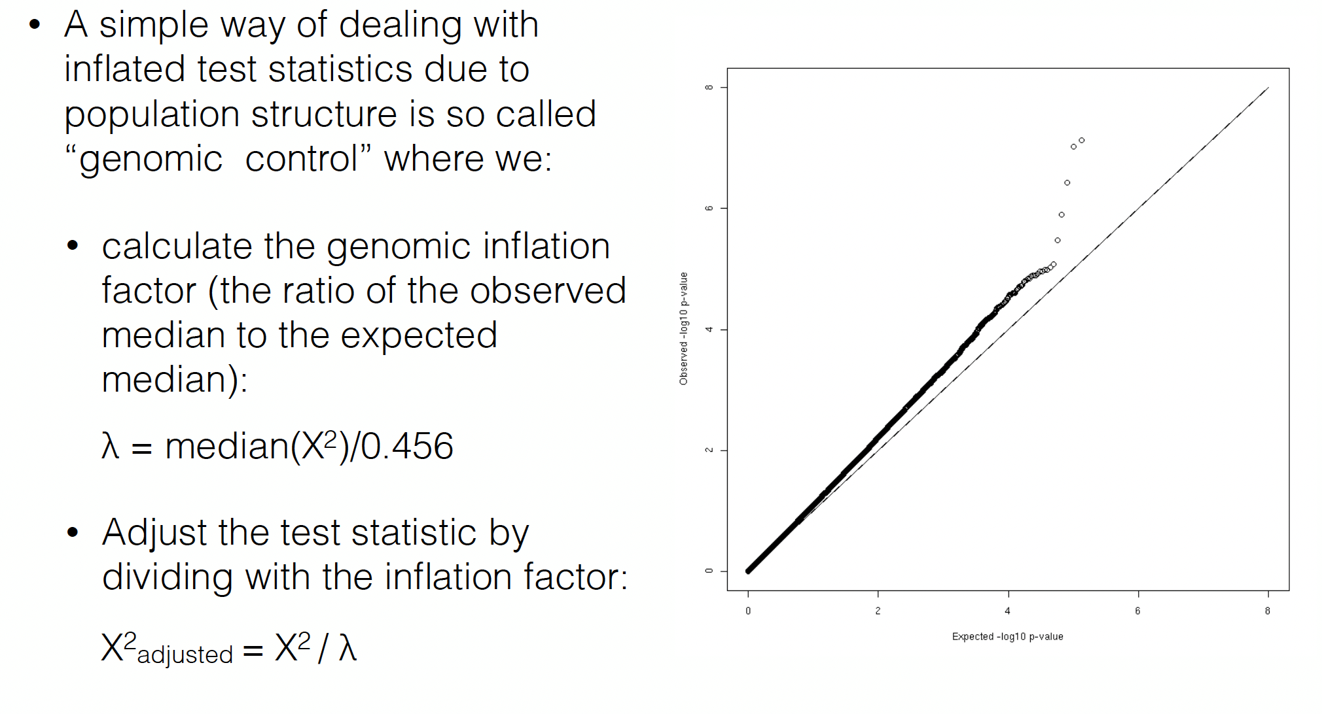
Ways to correct for Population Structure: Genomic control

Slide 19
Detecting stratification:
Chisq statistic = (#SAMPLES) correlation(genotype,phenotype)²
=
Median chisq statistic across all SNPs
0.455
Devlin & Roeder 1999 Biometrics

Slide 20
Detecting stratification:
T2D GWAS
500K SNPs
Approximately
matches uniform ☺
(null) distribution
λ_{GC} = 1.05
Diabetes Genetics Initiative 2007 Science

Slide 21
Detecting stratification:
T2D GWAS
500K SNPs
median
chisq = 0.48 (≈ 0.455)
P-value = 0.49 (≈ 0.50)
-log₁₀P = 0.31 (≈ 0.30)
λ_{GC} = 1.05 ⬄
Diabetes Genetics Initiative 2007 Science

Slide 22
Ways to correct for Population Structure: Principal components
Genomic control: Scale down the test-statistic so that its mean becomes the expected mean. Heavily used, but does not solve the problem!
Include the first K principle components in the model (Price et al., 2006).

Slide 23
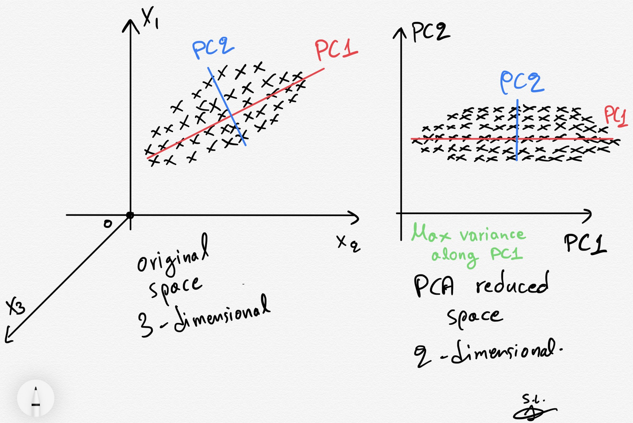
Principal components
The resulting projected data are essentially linear combinations of the original data capturing most of the variance in the data (Jolliffe 2002).

Slide 24
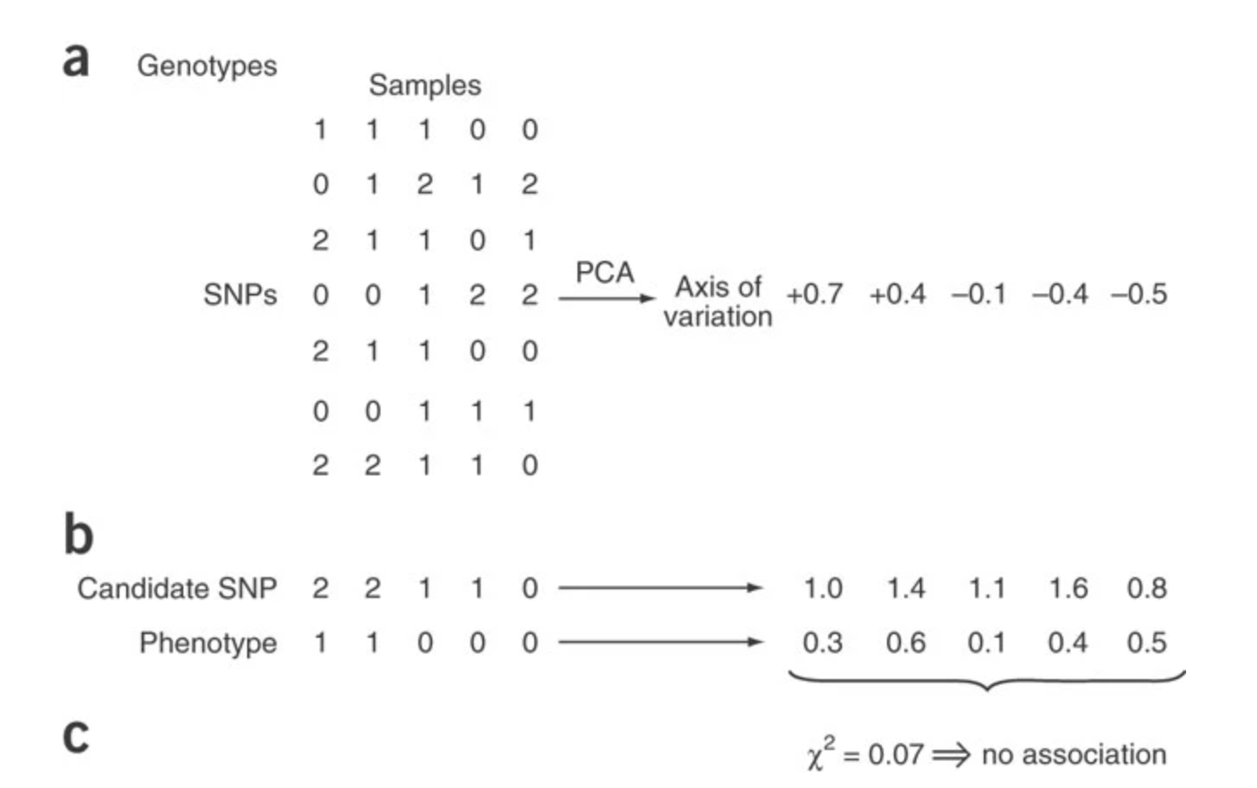
Pricipal component analyses
Principal components analysis is applied to genotype data to infer continuous axes of genetic variation; a single axis of variation is illustrated here.
(b) Genotype at a candidate SNP and phenotype are continuously adjusted by amounts attributable to ancestry along each axis, removing all correlations to ancestry.
(c) After ancestry adjustment, an association statistic between genotype at the candidate SNP and phenotype shows no significant association.
Price et al., 2006

Slide 25
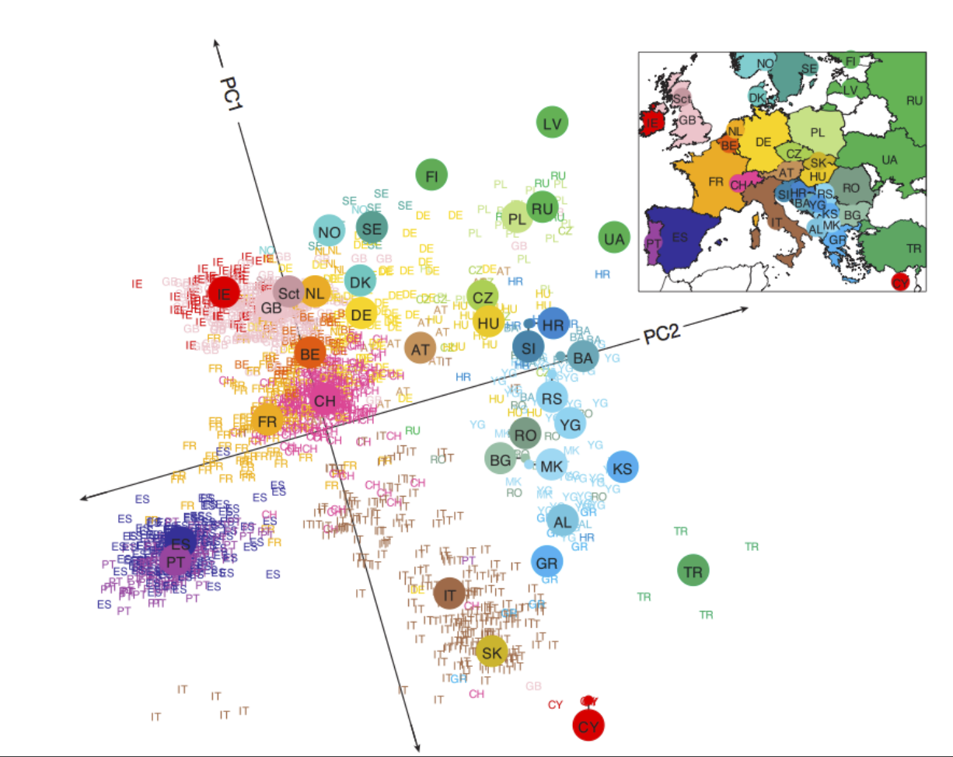
Plotting Pricipal components

Slide 26
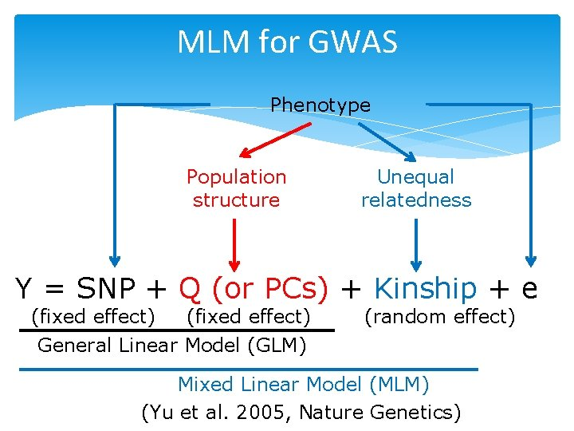
GWAS with PCA
Phenotype

Slide 27
Assignment 2 (GWAS and population structure)
To get started we need to:
Have Plink already
Have R and R studio installed on your machine
Download the R markdown version of the assignment here:
https://github.com/izabelcavassim/Analyses_of_genome_data/blob/main/Assignments/Assignment2.Rmd
For this exercise we will not work with the VCF format but the PLINK format, and you need to have the plink executable in the same folder as the datasets

